Slide 1
Operating System and
System Programming
Software College of SCU
四川大学软件学院 左航

Slide 2
Unit 9. Memory Operation and Performance
9.1 Memory Hierarchies
9.2 Locality of Reference
9.3 Fetch data from Memory Hierarchies
9.4 Cache-Aware Programming
9.5 Execution Time with Cache
9.6 Memory Mountain
201001V1.1

Slide 3
9.1. Memory Hierarchies(1/3)
The design constraints of a computer’s memory
  How much : Capacity : larger
  How fast : Speed : faster/ as fast as CPU
  How expensive : Price : cheaper

Slide 4
9.1. Memory Hierarchies(2/3)
Smaller,
faster,
and
costlier
(per byte)
storage
devices
L0:
registers
CPU registers hold words retrieved from L1 cache.
L1:
on-chip L1
cache (SRAM)
L1 cache holds cache lines retrieved from the L2 cache memory.
L2:
off-chip L2
cache (SRAM)
L2 cache holds cache lines retrieved from main memory.
L3:
main memory
(DRAM)
Larger,
slower,
and
cheaper
(per byte)
storage
devices
L4:
local secondary storage
(local disks)
L5:
remote secondary storage
(distributed file systems, Web servers)
201001V1.1

Slide 5
9.1. Memory Hierarchies(3/3)
CPU runs in a very high speed.
  The goal would be to have the data already in fast memory by the time the CPU actually requests it (pre-fetch the data and instruction)
Fundamental idea of a memory hierarchy:
  For each k, the faster, smaller device at level k serves as a cache for the larger, slower device at level k+1.
Why do memory hierarchies work?
  Locality of Reference
201001V1.1

Slide 6
Unit 9. Memory Operation and Performance
9.1 Memory Hierarchies
9.2 Locality of Reference
9.3 Fetch data from Memory Hierarchies
9.4 Cache-Aware Programming
9.5 Execution Time with Cache
9.6 Memory Mountain
201001V1.1

Slide 7
9.2Locality of Reference(1/6)
Pre-fetching
  预加载代码和数据？
Unfortunately, the future cannot be known fully.
  The execution is affected by run-time input (from the user, from other programs, and from the network) 比如分支语句的判断条件由运行时的变量值确定
  So, the computer takes guesses based on current execution and statistic sense.
201001V1.1

Slide 8
9.2Locality of Reference(2/6)
Memory addresses that have been accessed recently are likely to be accessed again. This is often called the principle of locality of reference. 局部性原理
  Loop and array
201001V1.1

Slide 9
9.2Locality of Reference(3/6)
Both DATA and INSTUCTIONS
Temporal locality
  addresses that are referenced are soon referenced repeatedly
Spatial locality
  ddresses near a referenced address will soon be accessed
int i,sum = 0;
for (i = 0; i < MAX; i++)
sum += array[i];
201001V1.1

Slide 10

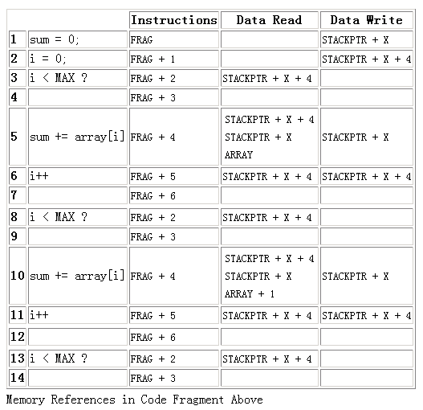
9.2Locality of Reference(4/6)
MAX is 2， i is 0
Instruction
Spatial locality
相邻指令执行
Instruction temper locality
jump
jump
Instruction temper locality
代码重复执行
jump
jump
jump
201001V1.1

Slide 11
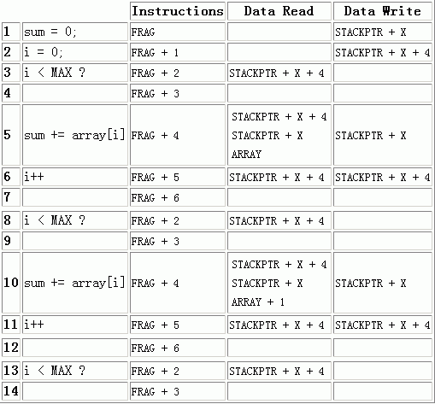
9.2Locality of Reference(5/6)
SUM
i
sum 地址：stackptr+x
i地址：stackptr+x+4
Sum和i 不断被重复访问
DATA temporal locality.
Sum 和 i 地址临近，数组元素array[i]互相临近 DATA spatial locality.
SUM
i
i
SUM
i
i

Slide 12
9.2Locality of Reference(6/6)
Think about:
  当ARR_SIZE从1增加到n, 数组从全部可以一次装入cache到无法全部加载入cache，程序性能是否会下降？空间局部性
  当stride从1增加到m, 一次加载后cache line里所有数据都会被访问到一次加载cache line里仅有一个数据被访问，程序性能是否会下降？空间局部性
  这个就是小节Memory Mountain的思路
for (i = 0; i < ARR_SIZE; i+=stride)
do something with array[i];
201001V1.1

Slide 13
Unit 9. Memory Operation and Performance
9.1 Memory Hierarchies
9.2 Locality of Reference
9.3 Fetch data from Memory Hierarchies
9.4 Cache-Aware Programming
9.5 Execution Time with Cache
9.6 Memory Mountain
201001V1.1

Slide 14
9.3 Fetch data from Memory Hierarchies(1/19)
disk(block)->main memory (page)->cache(line)
  Block size(扇区*2^n) >= page size > line size
201001V1.1
Notes:
Block size(=扇区×2^n)

Slide 15
9.3 Fetch data from Memory Hierarchies(2/19)
Program needs object d, which is stored in some block b.
Cache hit
  Program finds b in the cache at level k. E.g., block 14.
Cache miss
  b is not at level k, so level k cache must fetch it from level k+1. E.g., block 12.
  If level k cache is full, then some current block must be replaced (evicted). Which one is the “victim”?
    Placement policy: where can the new block go? E.g., b mod 4
    Replacement policy: which block should be evicted? E.g., LRU(最近最少使用算法)
    Write back, since 4 is modified
Request
12
14
Request
14
12
0
1
2
3
Level
k:
4*
9
14
12
14
3
4*
12
Request
12
4*
0
1
2
3
Level
k+1:
4
5
6
7
4*
8
9
10
11
12
13
14
15
12
201001V1.1

Slide 16
9.3 Fetch data from Memory Hierarchies(3/19)
Types of cache misses:
  Cold (compulsary) miss 冷不命中
    Cold misses occur because the cache is empty.
  Conflict miss冲突不命中
    Placement police: Most caches limit blocks at level k+1 to a small subset (sometimes a singleton) of the block positions at level k.
      E.g. Block i at level k+1 must be placed in block (i mod 4) at level k.
    Conflict misses occur when the level k cache is large enough, but multiple data objects all map to the same level k block.
    E.g. Referencing blocks 0, 8, 0, 8, 0, 8, ... would miss every time.
  Capacity miss 容量不命中
    Occurs when the set of active cache blocks (working set) is larger than the cache. (big array can’t be hold in 0~3 of level k)
201001V1.1
Notes:
6.3

Slide 17
9.3 Fetch data from Memory Hierarchies(4/19)
Fetch Policy(cache加载方法) when cache miss or write back
  Assume that a cache consists of 128 lines each of 32 bytes:
  When int a ,whose address is 0x0012ff04, is missing, loads 32 bytes (1 cache line) that contains a , from 0x0012ff00 to 0x0012ff1f (alignment).
line 0
32 bytes
a
........
line 1
32 bytes
line 127
32 bytes
a
Main memory
.....................
201001V1.1

Slide 18
9.3 Fetch data from Memory Hierarchies(5/19)
Risk
  The risk is that the program will not request the rest and the space consumed by it could have been better used to cache other values.
Penalty
  Lead to next cache missing and reload.
  Breaking the pipeline
201001V1.1

Slide 19
9.3 Fetch data from Memory Hierarchies(6/19)
struct point_color {
int c; int m; int y; int k;
};
struct point_color square[16][16];
int i, j;
for(i = 0; i < 16; i++) {
for(j = 0; j < 16; j++) {
square[i][j].c = 0;
square[i][j].m = 0;
square[i][j].y = 1;
square[i][j].k = 0;
}
}
Brief introduction to hit/miss rate
  What is the total number of writes?
  What is the total number of writes that miss in the cache? (cache line:32B)
    32B=4B*8
  What is the miss rate?
  每个像素sqare[i][j]占4*4=16B
  1 cache line 存放2个像素
  每访问2个像素加载一次cache line
201001V1.1

Slide 20
9.3 Fetch data from Memory Hierarchies(7/19)
struct point_color {
int c; int m; int y; int k;
};
struct point_color square[16][16];
int i, j;
for(i = 0; i < 16; i++) {
for(j = 0; j < 16; j++) {
square[i][j].c = 0;
square[i][j].m = 0;
square[i][j].y = 1;
square[i][j].k = 0;
}
}
What is the total number of writes?
16*16*4 =1024 (WRITES)
square[0][0].c = 0
write
201001V1.1

Slide 21
9.3 Fetch data from Memory Hierarchies(8/19)
struct point_color {
int c; int m; int y; int k;
};
struct point_color square[16][16];
int i, j;
for(i = 0; i < 16; i++) {
for(j = 0; j < 16; j++) {
square[i][j].c = 0;
square[i][j].m = 0;
square[i][j].y = 1;
square[i][j].k = 0;
}
}
What is the total number of writes that miss in the cache?
每2个miss 1个
Cache Miss =16*(16/2) =128
Miss Rate = (16*8) / (16*16*4) = 1/8 = 0.125
S[0][0].c | S[0][0].m | S[0][0].y | S[0][0].k | S[0][1].c | S[0][1].m | S[0][1].y | S[0][1].k
Cache Line
201001V1.1

Slide 22
9.3 Fetch data from Memory Hierarchies(9/19)
Placement Policy -- Where can a block(cache line) be placed in a cache?
  Direct mapped (直接映射): Each block has only one place it can appear in the cache.
  Set associative (组相联): A block can be placed in a restricted set of places. (2-way, 4-way, 8-way, etc.)
  Fully associative (全相联): A block can be placed anywhere in the cache.
201001V1.1

Slide 23
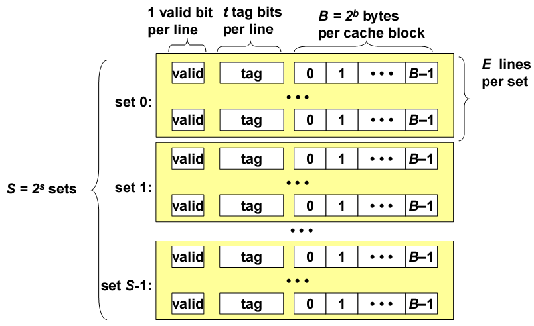
9.3 Fetch data from Memory Hierarchies(10/19)
此图组相联：若干组(set) ，每组若干cache line
如果所有cache line都在一个组(set)里，即全相连
如果每一个组(set)只有一个cache line，即直接映射
201001V1.1

Slide 24
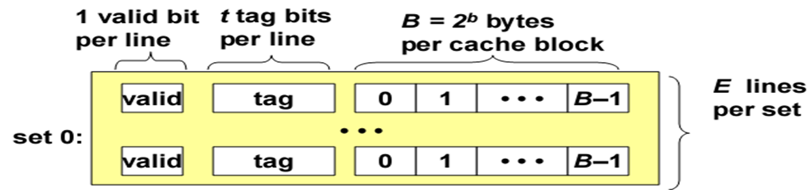
9.3 Fetch data from Memory Hierarchies(11/19)
One line contain valid,tag and block
block is where data saved
其实cache line 加载的时候，真正写入的是block大小的数据，而cache line包含辅助信息，我们所说的加载cache line, 指的是加载用户的一个block数据或指令
201001V1.1

Slide 25
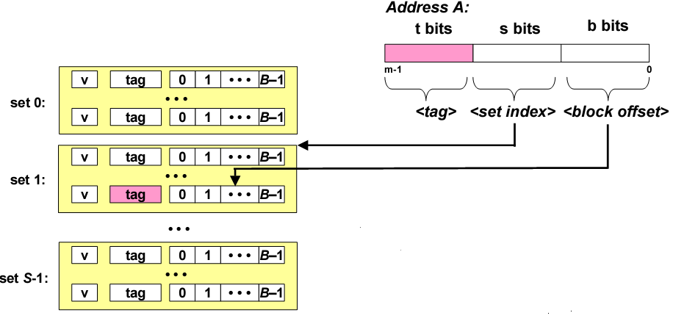
9.3 Fetch data from Memory Hierarchies(12/19)
Addressing Cache 如何按地址加载cache line
1组选择+2行匹配+3字提取
1
Process: s bits -> t bits -> b bits
  1. s bits: select sets
  2. t bits : The word at address A is in the cache if the tag bits in one of the <valid> lines in set <set index> match <tag>.
  3. b bits: The word contents begin at offset <block offset> bytes from the beginning of the block.
2
3
201001V1.1

Slide 26
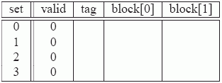
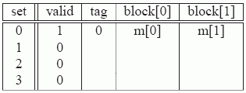
9.3 Fetch data from Memory Hierarchies(13/19)
Simulate the Cache in action:
Initially, the cache is empty (i.e., each valid bit is 0).
(t)0 (s)00 0(o)
Read word at address 0. Since the valid bit for set 0 is zero, this is a cache miss.
(t)0 (s)00 1(o)
Read word at address 1. This is a cache hit. The cache immediately returns m[1] from block[1] of the cache line. The state of the cache does not change.
201001V1.1

Slide 27
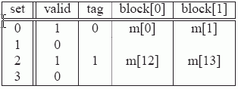
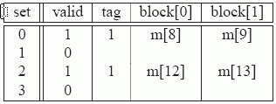
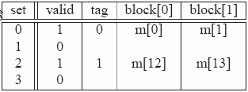
9.3 Fetch data from Memory Hierarchies(14/19)
(t)1 (index)10 1(o)
Read word at address 13. Since the cache line in set 2 is not valid, this is a cache miss. The cache loads block 6 into set 2 and returns m[13] from block[1] of the new cache line.
(t)1 (index)00 0(o)
Read word at address 8. This is a miss. The cache line in set 0 is indeed valid, but the tags do not match. The cache loads block 4 into set 0 (replacing the line that was there from the read of address 0)
Read word at address 0. This is another miss, due to the unfortunate fact that we just replaced block 0 during the previous reference to address 8.
201001V1.1

Slide 28
9.3 Fetch data from Memory Hierarchies(15/19)
Cache addressing problem
  由于address来自main memory，而main memory远大于cache
  所以按照地址中的S位来选择映射入哪个组，必然会导致多个块被映射到同一个组
  而当该组所有cache line满了以后，就需要替换策略进行替换
201001V1.1

Slide 29
9.3 Fetch data from Memory Hierarchies(16/19)
Suppose according to Placement Policy 0x0012fe70 0x0013fe70 mapped to same line
Tag’s content is changeable
0013
fe7
0
0012
fe7
0
0013
0012
0X0012FE70
…
0X0013FE70
201001V1.1

Slide 30
9.3 Fetch data from Memory Hierarchies(17/19)
Cache performance evaluation metrics: cache性能评估指标
  Miss rate.
  Hit rate.
  Hit time.
    The time to deliver a word in the cache to the CPU, including the time for set selection, line identification, and word selection. Hit time is typically 1 to 2 clock cycle for L1 caches.
  Miss penalty.
    Any additional time required because of a miss. The penalty for L1 misses served from L2 is typically 5 to 10 cycles. The penalty for L1 misses served from main memory is typically 25 to 100 cycles.
201001V1.1

Slide 31
9.3 Fetch data from Memory Hierarchies(18/19)
Impact of Cache Size
  Bigger, the better
Impact of Block Size
  increase the hit rate by exploiting any spatial locality
  for a given cache size, larger blocks imply a smaller number of cache lines, which can hurt the hit rate in programs with more temporal locality than spatial locality.空间局部性更良好
    negative impact on the miss penalty, since larger transfer times.
  Modern systems usually compromise with cache blocks that contain 4 to 8 words.
201001V1.1

Slide 32
9.3 Fetch data from Memory Hierarchies(19/19)
Impact of Associativity (parameter E, cache lines per set组里的line数目)
  decreases the vulnerability(弱点)of the cache to thrashing due to conflict misses
  higher associativity comes at a significant cost
    more tag /additional LRU state bits per line; additional control logic; higher hit time and miss penalty
  choice of associativity: a trade-off between the hit time and the miss penalty.
201001V1.1
Notes:
higher associativity，longer hit time 在组内寻址tag更慢了，因为line多，tag需要比较电路进行判断
而寻组往往是硬件并行译码完成，不是判断，是选中

Slide 33
Unit 9. Memory Operation and Performance
9.1 Memory Hierarchies
9.2 Locality of Reference
9.3 Fetch data from Memory Hierarchies
9.4 Cache-Aware Programming
9.5 Execution Time with Cache
9.6 Memory Mountain
201001V1.1

Slide 34
9.4 Cache-Aware Programming
The goal of such cache-aware programming is to increase the locality of a program's memory references, either spatially or temporally.
A program's locality might be insufficient for some or all of the caches.
  each case is different
201001V1.1

Slide 35
9.4 Cache-Aware Programming
9.4.1 case 1: Thrashing 抖动
9.4.2 case 2: Instruction Cache Overflow
9.4.3 case 3: Insufficient Spatial and Temporal Locality
201001V1.1

Slide 36
9.4.1 case 1: Thrashing(1/4)
This is a collision that happens repeatedly, causing thrashing: a condition in which data is transferred back and forth with no benefit.
  cache collision is one reason
almost of the CPU’s time is spending in swapping in/out.
E.G array elements load to same set while cache is not full (other sets are be available/empty)
201001V1.1

Slide 37
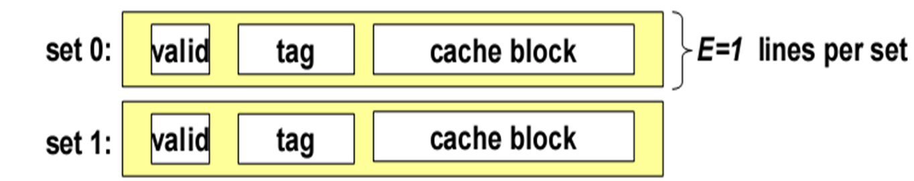
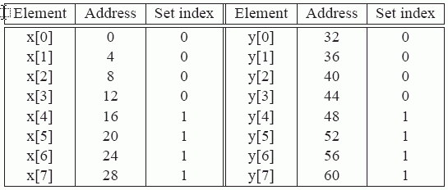
9.4.1 case 1: Thrashing(2/4)
set
float sum(float x[8], float y[8]) {
float sum = 0.0; int i;
for (i = 0; i < 8; i++)
sum += x[i] * y[i];
return sum; }
Address: 00000000
32 Byte Cache
Block size: 16B
2 cache line
Directly map cache
201001V1.1

Slide 38
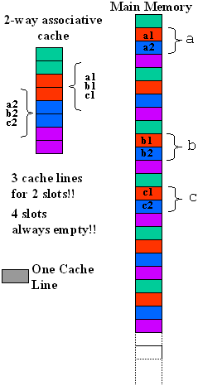
9.4.1 case 1: Thrashing(3/4)
int a[N];
<other stuff...>
int b[N];
<other stuff...>
int c[N];
for (i = 0; i < N; i++) {
c[i] = a[i] + b[i];
}
每次3个数据总映射到同2个line里，那么总有一个要覆盖另一个
201001V1.1

Slide 39
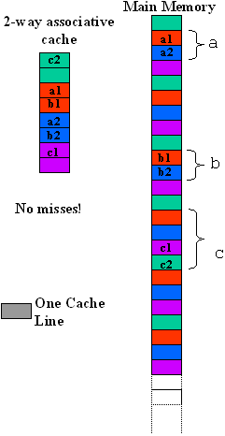
9.4.1 case 1: Thrashing(4/4)
#define CACHELINESIZE <Cache line size of system>
#define COFFSET ((2 * CACHELINESIZE) / sizeof(int))
int a[N];
<other stuff...>
int b[N];
<other stuff...>
int c[N + COFFSET];
for (i = 0; i < N; i++) {
c[i + COFFSET] = a[i] + b[i];
}
201001V1.1

Slide 40
9.4 Cache-Aware Programming
9.4.1 case 1: Thrashing 抖动
9.4.2 case 2: Instruction Cache Overflow
9.4.3 case 3: Insufficient Spatial and Temporal Locality
201001V1.1

Slide 41
9.4.2 case 2: Instruction Cache Overflow(1/2)
Below is a program involving three complicated operations:
for (i = 0; i < MAX; i++) {
<Complicated operation on A[i]>
<Complicated operation on B[i]>
<Complicated operation on C[i]>
}
for (i = 0; i < MAX; i++) {
<Complicated operation on A[i]>
}
for (i = 0; i < MAX; i++) {
<Complicated operation on B[i]>
}
for (i = 0; i < MAX; i++) {
<Complicated operation on C[i]>
}
201001V1.1

Slide 42
9.4.2 case 2: Instruction Cache Overflow(2/2)
There is a possibility that the instructions for the body of the for loop will overflow the capacity of the L1 instruction cache,
  and that therefore, in each iteration of the loop, each instruction will have to be fetched from main memory, again and again.
201001V1.1

Slide 43
9.4 Cache-Aware Programming
9.4.1 case 1: Thrashing 抖动
9.4.2 case 2: Instruction Cache Overflow
9.4.3 case 3: Insufficient Spatial and Temporal Locality
201001V1.1

Slide 44
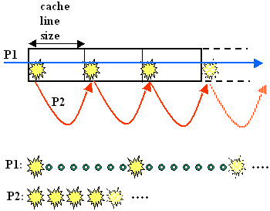
9.4.3 case 3: Insufficient Spatial and Temporal Locality(1/6)
int I
int sum=0;
int data[ARRAY_SIZE]
for (i = 0; i < ARRAY_SIZE; i += stride)
sum += data[i];
201001V1.1

Slide 45
9.4.3 case 3: Insufficient Spatial and Temporal Locality(2/6)
Explain of former figure
  P1:Suppose the cache line is 32 bytes wide, as it often is. If a program is reading contiguous 4-byte integers (continuous), the reference to the first will cause the first eight integers (integers 0–7) to be loaded into the cache.
    The reference to the 9th will cause integers 8–15 to be loaded, and so on. The hit ratio, even on a cold cache, will be at least 7/8, or 0.875.
  P2: Now consider a program that reads integers with a stride of eight or more. This means that the program reads the first integer, then the 9th (or higher), then the 17th etc.
  This will explain the figure 6-45 in textbook CSAPP
201001V1.1

Slide 46
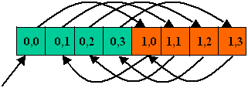

9.4.3 case 3: Insufficient Spatial and Temporal Locality(3/6)
Swapping the order of the for loops results in a much more cache-friendly execution, with at most one cache miss per cache line.
int data[M][N];
for (j = 0; j < M; j++) {
for (i = 0 ; i < N; i++) {
sum += data[ i ] [ j ];
}
}
int data[M][N];
for (j = 0; j < M; j++) {
for (i = 0 ; i < N; i++) {
sum += data[ j ] [ i ];
}
}
201001V1.1

Slide 47


9.4.3 case 3: Insufficient Spatial and Temporal Locality(4/6)
Can we avoid the cache miss by exchange the i, j?
  Insufficient Temporal Locality
  Can we do anything to improve the performance?
int original[M][N];
int transposed[N][M];
for (j = 0; j < M; j++) {
for (i = 0; i < N; i++) {
transposed[i][j] = original[j][i];
}
}
201001V1.1

Slide 48
9.4.3 case 3: Insufficient Spatial and Temporal Locality(5/6)
We can break up the large image into many images of the right size to improve the hit ratio.
  Loop Tiling (循环分块)
1 | 9
2 | 10
3 | 11
4 | 12
5 | 13
6 | 14
7 | 15
8 | 16
1 | 5 | 9 | 13
2 | 6 | 10 | 14
3 | 7 | 11 | 15
4 | 8 | 12 | 16
相同底色表示在cache中存放于同一位置
201001V1.1

Slide 49
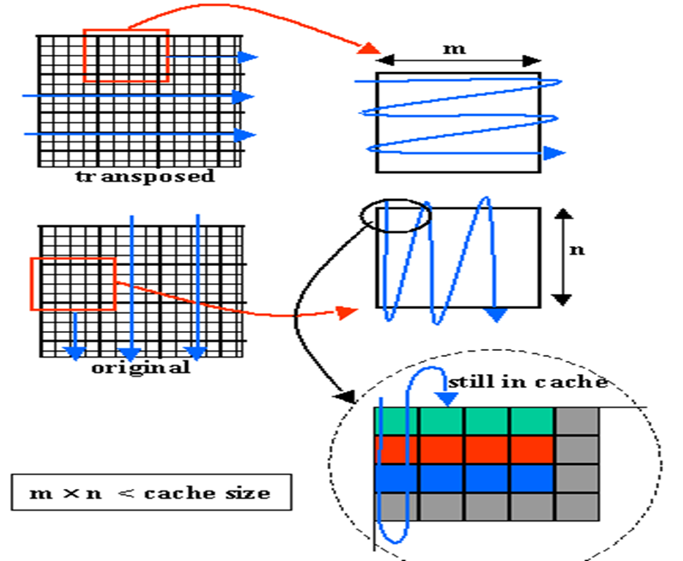
9.4.3 case 3: Insufficient Spatial and Temporal Locality(6/6)
int original[M][N];
int transposed[N][M];
for (k = 0; k < M / m; k++) {
for (l = 0; l < N / n; k++) {
for (i = k*m; i < (k+1)*m; i++) {
for (j = l*n; j < (l+1)*n; j++) {
transposed[j][i] = original[i][j];
}
}
}
}
int original[M][N];
int transposed[N][M];
for (i = 0; i < M; i++) {
for (j = 0; j < N; j++) {
transposed[j][i] = original[i][j];
}
}
201001V1.1

Slide 50
Unit 9. Memory Operation and Performance
9.1 Memory Hierarchies
9.2 Locality of Reference
9.3 Fetch data from Memory Hierarchies
9.4 Cache-Aware Programming
9.5 Execution Time with Cache
9.6 Memory Mountain
201001V1.1

Slide 51
9.5 Execution Time with Cache(1/6)
Show the benefit of cache memory of different levels
/* Assumes n is a power of two */
void merge_sort (int * data, int n) {
int half = n >> 1;
if (n == 1) return;
merge_sort(data, half);
merge_sort(data + half, half);
merge(data, data + half, half);
}
201001V1.1

Slide 52
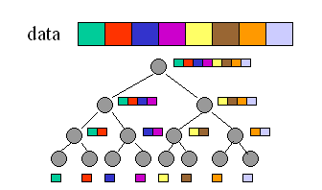
9.5 Execution Time with Cache(2/6)
Graph of Merge Sort合并排序
内存存放顺序
内存访问顺序
201001V1.1
Notes:
叶节点从左至右01234排序（即函数递归调用时访问数据的时间顺序），首先是0返回(n=1)，1返回，然后0和1比并排序，同理2和3，然后0123合并merge
幻灯63，0,1,2,实际是1byte数据

Slide 53
9.5 Execution Time with Cache(3/6)
Assumption
  The caches are fully associative.
  LRU is used for replacement (近期最少使用法).
  The execution time is given in terms of the access times in nanoseconds (ns) for the L1 cache (T1), L2 cache (T2), L3 cache (T3), and main memory (Tm).
201001V1.1

Slide 54
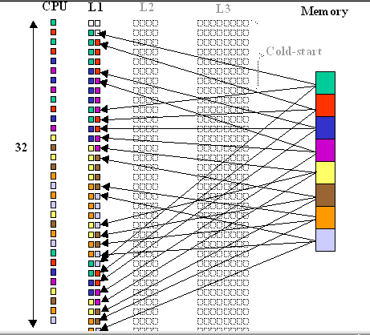

9.5 Execution Time with Cache(4/6)
Merge Sort in L1 only (2 lines, 1 byte block) 计算机只有1级cache+MM
Look at the total time
内存访问顺序
201001V1.1

Slide 55
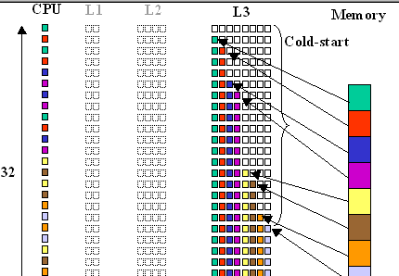

9.5 Execution Time with Cache(5/6)
Merge Sort
(8 lines, 1 byte block)计算机只有3级cache+MM
Look at the total time
201001V1.1

Slide 56
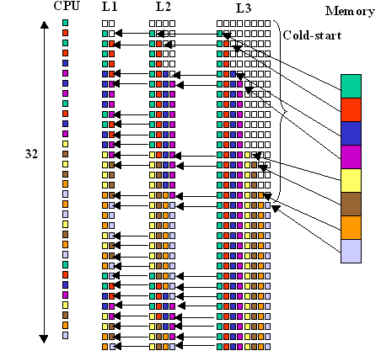
9.5 Execution Time with Cache(6/6)
Merge Sort in Three Levels of Cache
Look at the total time
201001V1.1

Slide 57
Unit 9. Memory Operation and Performance
9.1 Memory Hierarchies
9.2 Locality of Reference
9.3 Fetch data from Memory Hierarchies
9.4 Cache-Aware Programming
9.5 Execution Time with Cache
9.6 Memory Mountain
  此部分介绍如何通过数组的大小及运算耗时测出缓存吞吐量，从而图形化观察缓存
201001V1.1

Slide 58
9.6 Memory Mountain(1/6)—CSAPP6.6
Read throughput 读吞吐量(read bandwidth)
  Number of bytes read from memory per second (MB/s)
Memory mountain
  In the file memory_mountain.rar
  Measured read throughput as a function of spatial and temporal locality.
  Compact way to characterize memory system performance.
    Cache size
    Cache block/line size

Slide 59
9.6 Memory Mountain(2/6)
/* The test function */
void test(int elems, int stride) {
int i, result = 0;
volatile int sink;
for (i = 0; i < elems; i += stride)
result += data[i];
sink = result; /* So compiler doesn't optimize away the loop */
}
/* Run test(elems, stride) and return read throughput (MB/s) */
double run(int size, int stride, double Mhz)
{
double cycles;
int elems = size / sizeof(int);
test(elems, stride); /* warm up the cache */
cycles = fcyc2(test, elems, stride, 0); /* call test(elems,stride) */
return (size / stride) / (cycles / Mhz); /* convert cycles to MB/s */
}
None sense here
Notes:
Volatile 关键字是一种类型修饰符，用它声明的类型变量表示可以被某些编译器未知的因素更改，比如：操作系统、硬件或者其它线程等。
遇到这个关键字声 明的变量，编译器对访问该变量的代码就不再进行优化，从而可以提供对特殊地址的稳定访问
volatile 影响编译器编译的结果,指出，volatile 变量是随时可能发生变化的，与volatile变量有关的运算，不要进行编译优化，以免出错，（VC++ 在产生release版可执行码时会进行编译优化，加volatile关键字的变量有关的运算，将不进行编译优化。）。

Slide 60
9.6 Memory Mountain(3/6)
/* mountain.c - Generate the memory mountain. */
#define MINBYTES (1 << 10) /* Working set size ranges from 1 KB */
#define MAXBYTES (1 << 23) /* ... up to 8 MB */
#define MAXSTRIDE 16 /* Strides range from 1 to 16 */
#define MAXELEMS MAXBYTES/sizeof(int)
int data[MAXELEMS]; /* The array we'll be traversing */
int main()
{
int size; /* Working set size (in bytes) */
int stride; /* Stride (in array elements) */
double Mhz; /* Clock frequency */
init_data(data, MAXELEMS); /* Initialize each element in data to 1 */
Mhz = mhz(0); /* Estimate the clock frequency */
for (size = MAXBYTES; size >= MINBYTES; size >>= 1) {
for (stride = 1; stride <= MAXSTRIDE; stride++)
printf("%.1f\t", run(size, stride, Mhz));
printf("\n");
}
exit(0);
}

Slide 61
9.6 Memory Mountain(3/6)
hints:
  A smaller size indicates better temporal locality.
  A smaller stride indicates better spatial locality.

Slide 62
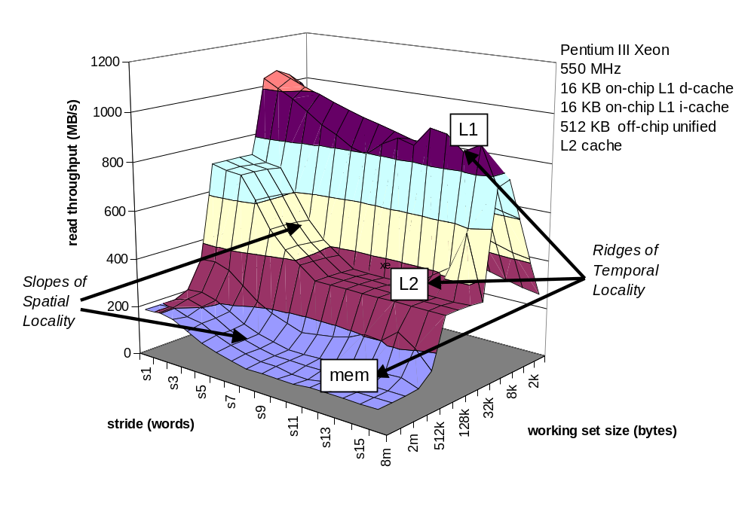
9.6 Memory Mountain(4/6)

Slide 63
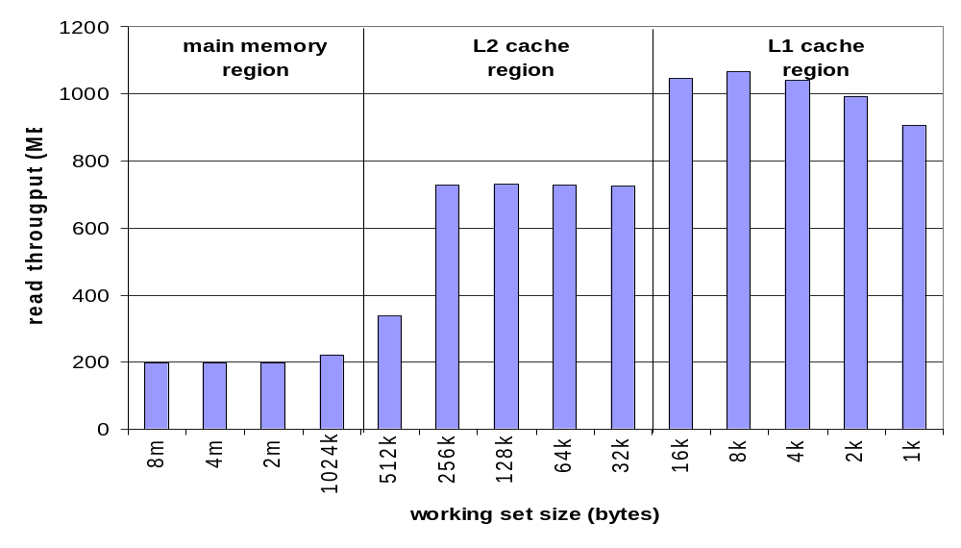
9.6 Memory Mountain(5/6)
Ridges峰 of Temporal Locality: Slice through the memory mountain with stride=1
  illuminates read throughputs of different caches and memory

Slide 64
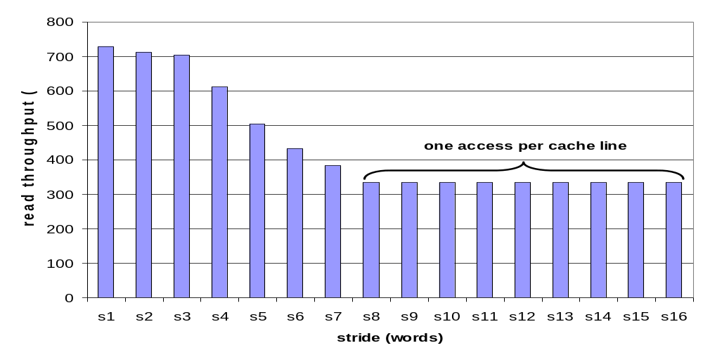
9.6 Memory Mountain(6/6)
A Slope of Spatial Locality : Slice through memory mountain with size=256KB
  shows cache block/line size.

